Slide 1
GUIDELINES IN HCI

Slide 2
PRINCIPLES OF GOOD DESIGN

Slide 3
PRINCIPLES OF GOOD DESIGN
▪ Naturalness
▪ Consistency
▪ Non redundancy
▪ Supportiveness
▪ Flexibility

Slide 4
NATURALNESS
▪ Does not cause the user to alter significantly in interacting with the system.
▪ Use of language should be natural.
▪ Jargons may be desirable- provided its used everyday
▪ Use of non standard abbreviations shall be avoided, which may slow down the word recognition

Slide 5
CONSISTENCY
▪ Consistent layout of screen should be maintained, which shall allows the users to fulfill the similar functionalities.
▪ The dialogues should be consistent with established norms.
▪ Eg: In Pcs & ATM Return or Enter Command means confirming – Changing that may lead to confusing

Slide 6
NON REDUNDANCY
▪ Requires the user to input only minimum information for the system.
▪ Eg: 10 instead of 00010 – Avoid zeros before
▪ User shall not ask to give the information, which shall be automatically fetched from the system
▪ Too much of information on one screen is detrimental to the clarity of the screen and will delay the user.

Slide 7
SUPPORTIVENESS
▪ It refers to the amount of assistance the dialogue provide to the users in running the system.
▪ Instructions shall be provided by system prompts and by additional help facilities.
▪ Error message should be helpful and not obscure.

Slide 8
FLEXIBILITY
It refers to how well it can provide or tolerate different levels of user familiarity and performance.
It depends on the skill of the expertise of users in relationship to given task.
Eg: Hierarchical menu structures shall be used for first time user-may be navigated using commands

Slide 9
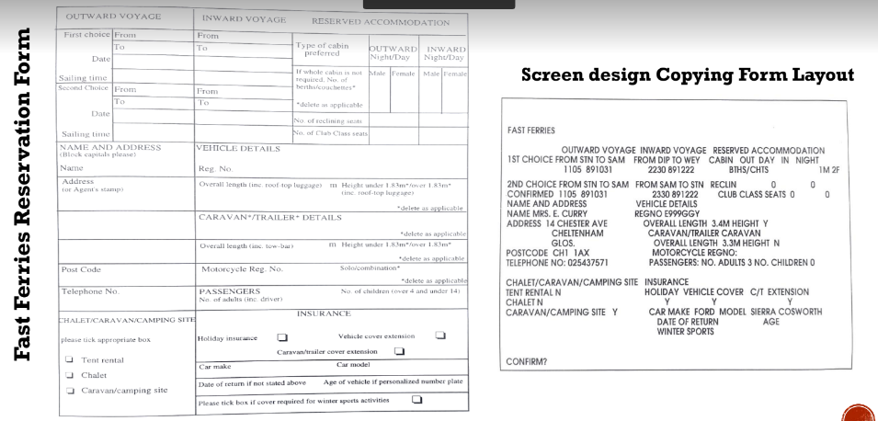

Slide 10
PRINCIPLES OF GOOD DESIGN
Non redundancy
Naturalness
Consistency
Supportiveness
Flexibility

Slide 11
GOLDEN RULES OF INTERFACE DESIGN
8 Golden Rules of Interface Design
▪ Ben Shneiderman American computer scientist and professor at the University of Maryland Human-Computer Interaction Lab

Slide 12
8 GOLDEN RULES OF INTERFACE DESIGN
Strive for consistency
▪ In actions, sequences, layouts, commands, etc. users become familiar with the digital landscape of your product so they can achieve their goals more easily.
Enable frequent users to use shortcuts
▪ Special keys sequences , macros to perform regular or familiar functions.
▪ Frequent / advanced user can navigate and operate the user interface more quickly and effortlessly.

Slide 13
8 GOLDEN RULES OF INTERFACE DESIGN
Offer Informative Feedback
For every user action apt to the action’s magnitude. The user should know where they are at and what is going on at all times
Design Dialogs to Yield Closure
User Knows when the task is completed. Don’t keep your users guessing. Tell them what their action has led them to.
Closure the Famous ATM Insert.

Slide 14
8 GOLDEN RULES OF INTERFACE DESIGN
Permit Easy Reversal of Actions
▪ Relieves anxiety and promotes exploration
▪ Should we introduce CONTROL Z!!!
Offer Error Prevention or Error Handling
▪ Users prevented from making errors or mistakes
▪ Clear feedback in case of errors to recover
▪ When unavoidable errors occur, ensure users are provided with simple, intuitive step-by-step instructions to solve the problem
▪ Flag the text fields where instructions to solve the problem
▪ Flag the text fields where the users forgot to provide input in an online form

Slide 15
8 GOLDEN RULES OF INTERFACE DESIGN
Support Internal Locus of Control
▪ User has full control of the system
Reduce Short Term Memory Load
▪ Keep displays simple
▪ Consolidate multiple page displays - give time for learning actions

Slide 16

WRAP UP
Consistency
Contain consistent
graphic elements
regardless of whether
it’s a version from the
1980’s or the 2010’s.

Slide 17

WRAP UP
SHORTCUTS
Commonly used
examples include copy
and paste (Command-C
and Command-V)

Slide 18
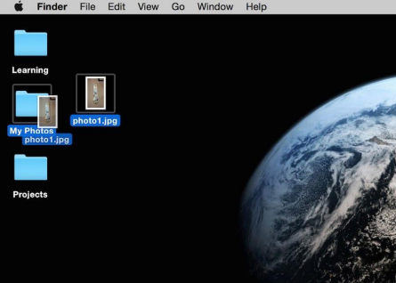
WRAP UP
INFORMATIVE FEEDBACK
The ‘Learning’ folder
becomes highlighted as
the user clicks on a
folder on a Mac desktop.

Slide 19
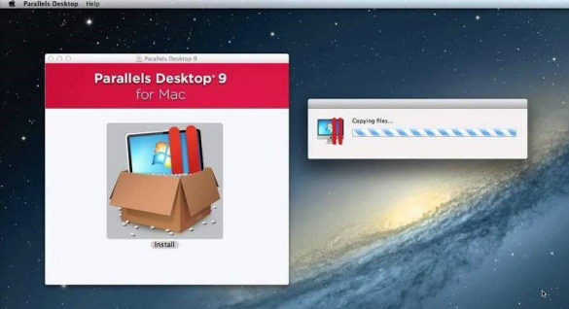
WRAP UP
DIALOGUE
As the user installs the
program “Parallels
Desktop 9”, it shows that
it is currently “copying
files”.

Slide 20
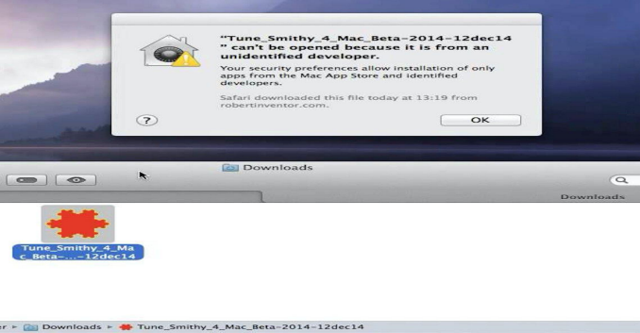
WRAP UP
ERROR HANDLING

Slide 21
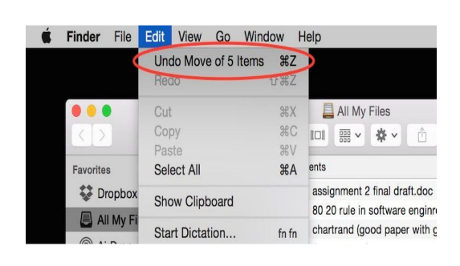
WRAP UP
PERMIT REVERSAL OF ACTIONS
The user can undo a
previous action quickly
and easily.

Slide 22
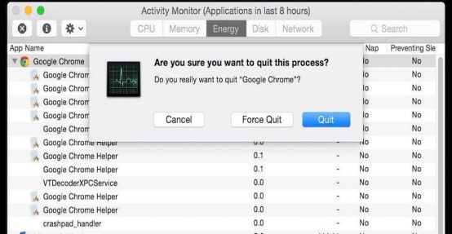
WRAP UP
SUPPORT INTERNAL LOCUS OF CONTROL
The user is able to Quit
or Force Quit a program
if it crashes.

Slide 23

WRAP UP
Reduce short-term memory load
Apple implements the
rules of consistency by
displaying the same
bottom menu across
different versions of the
iOS.

Slide 24
